Slide 1
Descriptive text definition
Descriptive text shows, through careful observation, how a thing is done (a place, a person, an animal), highlighting the features, qualities, distinctive aspects, in order to furnish a clear and complete conception.
The main objective of a descriptive text is to inform: it is the case of the technical descriptions in scientific encyclopedias, handbooks, dictionaries, guides.

Slide 2
Descriptive text definition
This kind of texts can also express, through a description, feelings, emotions or moods: in this case prevails expressive purpose.
This type of texts is widespread in all areas of social life. They are often placed within a narrative, expository or argumentative. Any text journalism, advertising, scientific manual, etc ... contains, in fact, one or more descriptive parts.

Slide 3
Descriptive text structure
Descriptive Texts, although with some variation depending on on the object described , the communication situation and the purpose for which they are produced, have , in their structure , some general characteristics.

Slide 4
Descriptive text structure
The referent , that is the thing, the person or the animal described;
The quality and the parties, that is the elements of the referent that listed in the description. To provide a clear picture of the object is necessary to make specific references to the various parts from wich it is composed and to the qualities that distinguish it.

Slide 5
Subjective and Objective description
Description can be done in a personal (subjective) or impersonally (objective).
In subjective description, authors propose the referent of the description (ie the object described) from their points of view; giving a representation filtered through their particular ways of seeing and feeling the reality around them, in order to arouse similar emotions in the reader. The main purpose of this kind of text is obviously persuasive or emotional.

Slide 6

Subjective description
Example:
“Emily was somewhat surprised, on the following day, to find that Annette had heard of Madame Montoni's confinement in the chamber over the portal, as well as of her purposed visit there, on the approaching night. That the circumstance, which Barnardine had so solemnly enjoined her to conceal, he had himself told to so indiscreet an hearer as Annette, appeared very improbable, though he had now charged her with a message, concerning the intended interview. He requested, that Emily would meet him, unattended, on the terrace, at a little after midnight, when he himself would lead her to the place he had promised; a proposal, from which she immediately shrunk, for a thousand vague fears darted athwart her mind, such as had tormented her on the preceding night, and which she neither knew how to trust, or to dismiss. It frequently occurred to her, that Barnardine might have deceived her, concerning Madame Montoni, whose murderer, perhaps, he really was; and that he had deceived her by order of Montoni, the more easily to draw her into some of the desperate designs of the latter.” (A. Radcliffe, The Mysteries of Udolpho, Volume 3, Chapter I)

Slide 7
Subjective and Objective description
In an objective description the author does not express emotions or personal judgments, introducing the referent in an impersonal and objective way. The primary purpose of this type of description is informative.

Slide 8
Objective description
Example:
“For the next eight or ten months, Oliver was the victim of a systematic course of treachery and deception. He was brought up by hand. The hungry and destitute situation of the infant orphan was duly reported by the workhouse authorities to the parish authorities. The parish authorities inquired with dignity of the workhouse authorities, whether there was no female then domiciled in 'the house' who was in a situation to impart to Oliver Twist, the consolation and nourishment of which he stood in need. The workhouse authorities replied with humility, that there was not. Upon this, the parish authorities magnanimously and humanely resolved, that Oliver should be 'farmed,' or, in other words, that he should be dispatched to a branch-workhouse some three miles off, where twenty or thirty other juvenile offenders against the poor-laws, rolled about the floor all day, without the inconvenience of too much food or too much clothing, under the parental superintendence of an elderly female, who received the culprits at and for the consideration of sevenpence-halfpenny per small head per week. Sevenpence-halfpenny's worth per week is a good round diet for a child; a great deal may be got for sevenpence-halfpenny, quite enough to overload its stomach, and make it uncomfortable.” (C. Dickens, Oliver Twist, Chapter 2, TREATS OF OLIVER TWIST'S GROWTH, EDUCATION, AND BOARD)

Slide 9
Style feature of a descriptive text
The main characteristics of a descriptive text from a linguistic point of view are the following:
- The use of spatial indicators: adverbs, prepositions, adverbial phrases (front, back, bottom, top, left, right, etc ...), which are essential in the description of a place, a person, for the placement of an object in space, and for the definition of the parts that make it up;
- The use of adjectives, indicating the quality of the contact person;

Slide 10
Style feature of a descriptive text
- The use of short sentences, for clarity of description;
- The use of verbs in simple present and past;
- The richness and variety in the use of terms, which is essential to provide a clear, accurate and representative conception of the referent and its components.

Slide 11
Description techniques
Depending on the subject to describe the purpose and recipient, also vary the techniques of the same description.
A discriminating factor is surely the point of view from which you choose to observe and describe reality (a window onto a courtyard, the top floor of a palace, the center of a square).

Slide 12
Description techniques
You can choose a particular criterion of order, spatial or hierarchical, according to which you can set the description. In the first case you proceed from the top to the bottom or vice versa, from the left to the right or from the right to the left; in the second case you can be as low as an overview to reach the analysis of the image ditails, or vice versa.
We can find description everywhere: novels, poems, songs, brochure, etc.

Slide 13
Description in a Poem
Example:
“And now, unveil'd, the Toilet stands display'd,
Each Silver Vase in mystic Order laid.
First, rob'd in White, the Nymph intent adores
With Head uncover'd, the Cosmetic Pow'rs.
A heav'nly Image in the Glass appears,
To that she bends, to that her Eyes she rears” [l.121-6]
(A. Pope, The rape of the Lock, I)

Slide 14
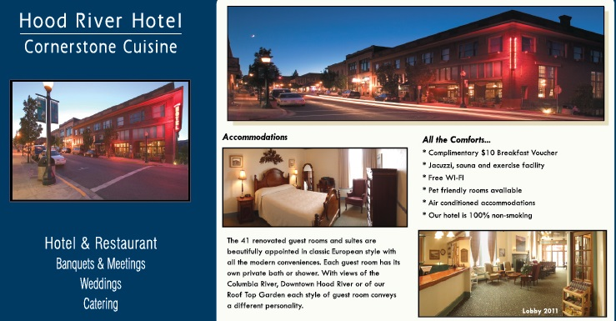
Description in a Brochure

